Slide 1
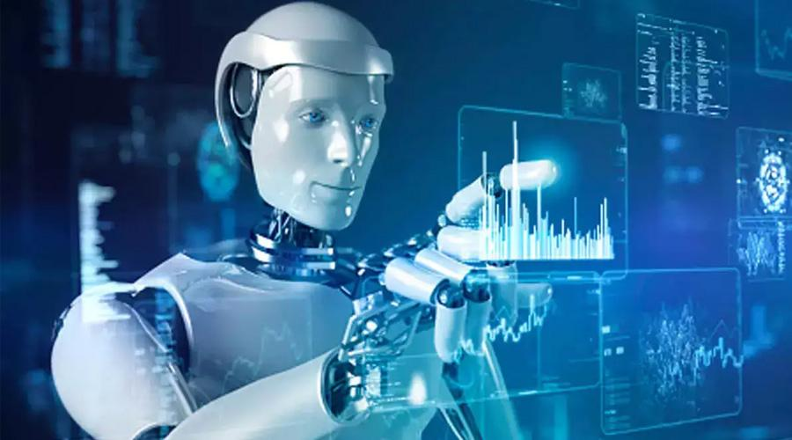
CHATBOT IN PYTHON
create a chatbot in python

Slide 2
CONTENTS
OBJECTIVE
ABSTRACT
ESSENTIAL TO CREATE A CHATBOT
DESIGN THINKING
APPLICATION
CONCLUSION

Slide 3
OBJECTIVE
The primary objective of creating a chatbot in Python for exceptional customer service is to enhance the overall user experience and increase customer satisfaction.

Slide 4
ABSTRACT
A chatbot enables a user to simply ask questions in the same manner that they would respond to humans.
The most well-known chatbots currently are voices chatbots: SIRI and Alexa.
However, chatbots have been adopted and brought into the daily application at a high rate on the computer chat platform.

Slide 5
ESSENTIAL TO CREATE A CHATBOT
Purpose and Scope
NLP Integration
User Interface
Predefined Responses
Testing and Deployment
Monitoring and Improvement

Slide 6
DESIGN THINKING
Functionality.
User Interface.
Natural Language Processing.
Responses.
Testing and Improvement.

Slide 7
Functionality
Define the scope of the chatbot's abilities, including answering common questions, providing guidance, and directing users to appropriate resources.

Slide 8
User Interface
Determine where the chatbot will be integrated (website, app) and design a user-friendly interface for interactions.

Slide 9
Natural Language Processing
Implement NLP techniques to understand and process user input in a conversational manner.

Slide 10
Responses
Plan responses that the chatbot will offer, such as accurate answers, suggestions, and assistance.

Slide 11
Testing and Improvement
Continuously test and refine the chatbot's performance based on user interactions.

Slide 12
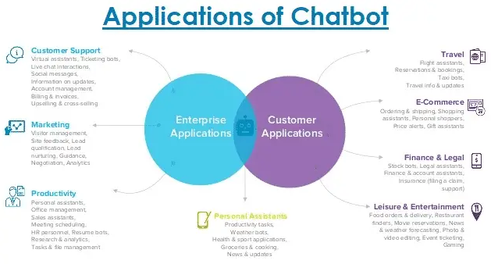

Slide 13
CONCLUSION
In this project, we made a college-specific chatbot system that can be custom and fits in an education domain chatbot the addition of this chatbot system in the college website will make the webpage more user interactive as it responds to the user queries very accurately as it is a domain-specific chatbot system, and furthermore we had investigated our college chatbot system design stages.

